Slide 1
Journey to the End of the Earth By Tishani Doshi
A Powerpoint Presentation of
An Interactive Class
by
Mr. Sebi Paul K, PGT English
JNV Kadapa, Andhra Pradesh

Slide 2
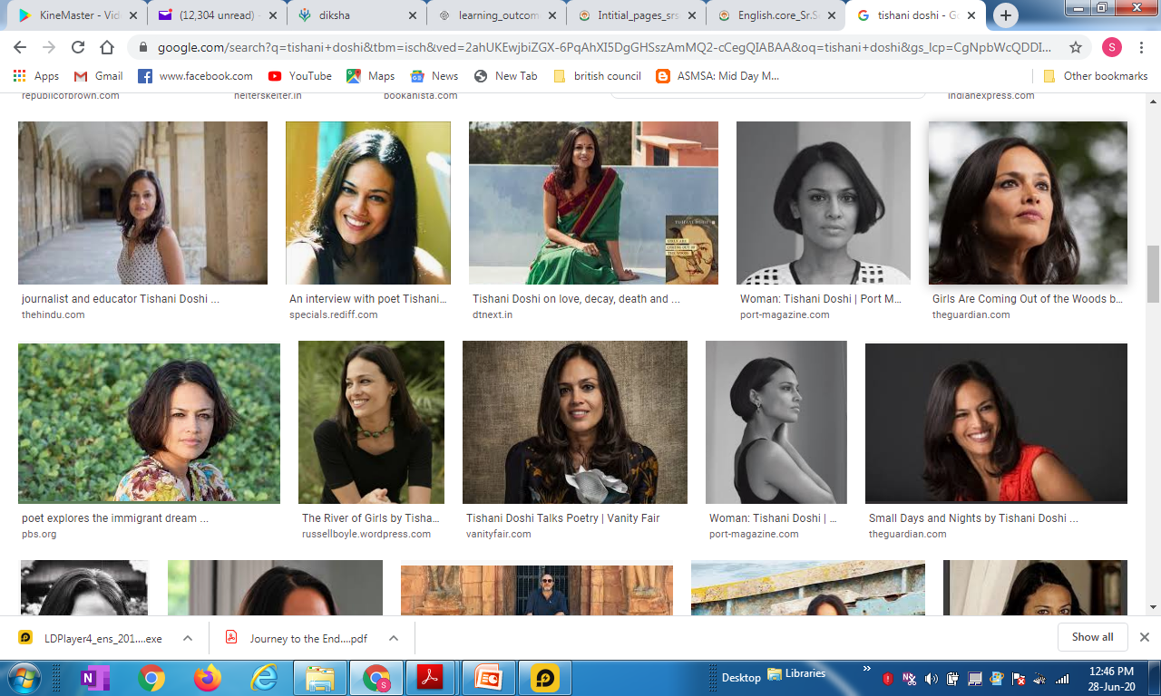
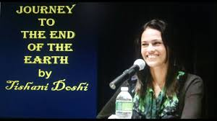
Task 1 : Know the Author
Tishani Doshi (1975 – still alive) Poet, Journalist, Novelist, Dancer

Slide 3

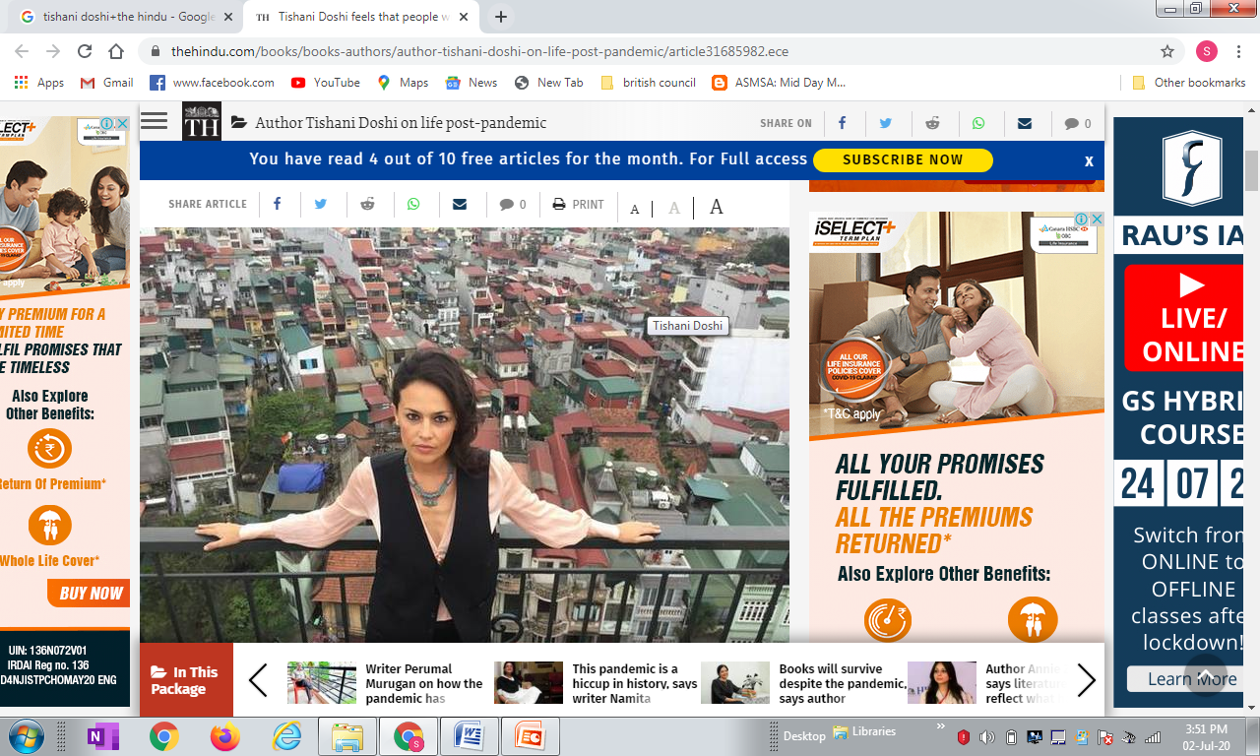
Tishani Doshi – A Profile A very Versatile Personality
Tishani Doshi is a writer and dancer
Born in Chennai in 1975 – to Welsh mother and a Gujarati father.
Studied Business Administration and Communications from the US
Moved to London in 1999, becoming assistant to the advertising department
of Harper's and Queen magazine.
In 2001, returned to India where she became a dancer with the choreographer
Chandralekha.
Works as a freelance journalist, contributing to various newspapers such as
The Guardian, The International Herald Tribune, The Hindu &
The New Indian Express
https://www.youtube.com/watch?v=Q4ZheZ-3ZCk&t=354s
Visit the link above to see and hear Tishani Doshi in action

Slide 4

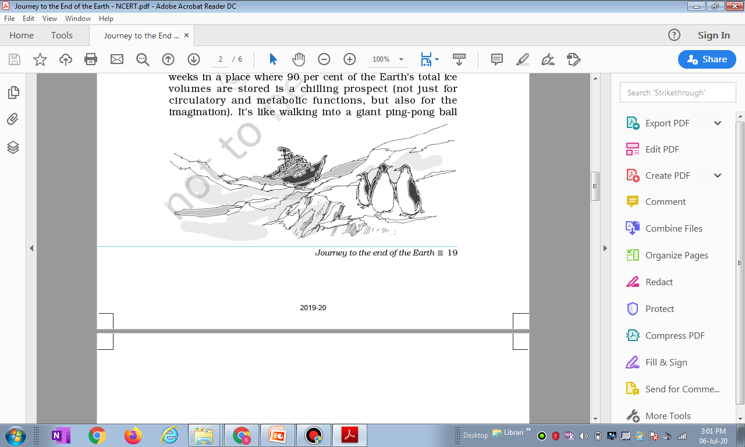
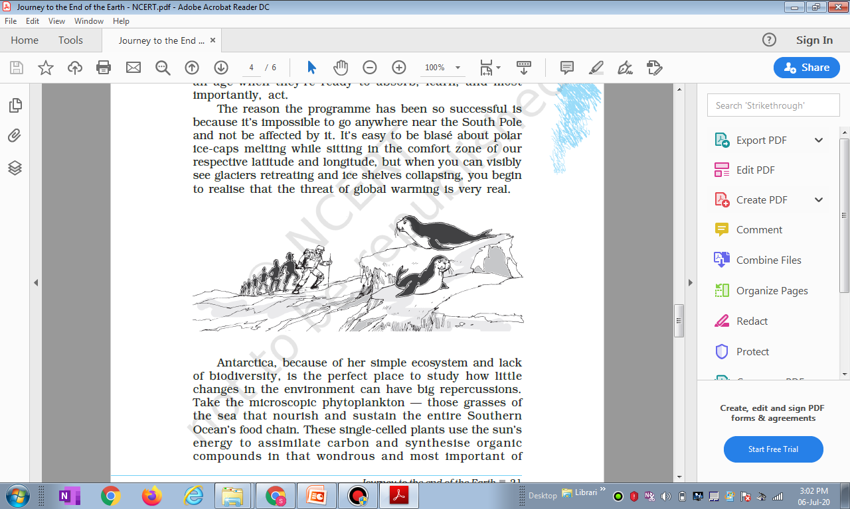

Task 2 : Working up your Imagination / Creativity / Previous Knowledge
Seeing the title of the lesson and the sketches inside, any guesses about the theme of the lesson ?
What do you think are the ideas discussed in the lesson?
Does the title of the lesson remind you of another similar title – of a famous novel ? (“Journey to the Centre of the Earth” by Jules Verne) & “Around the world in 80 Days” by Jules Verne

Slide 5
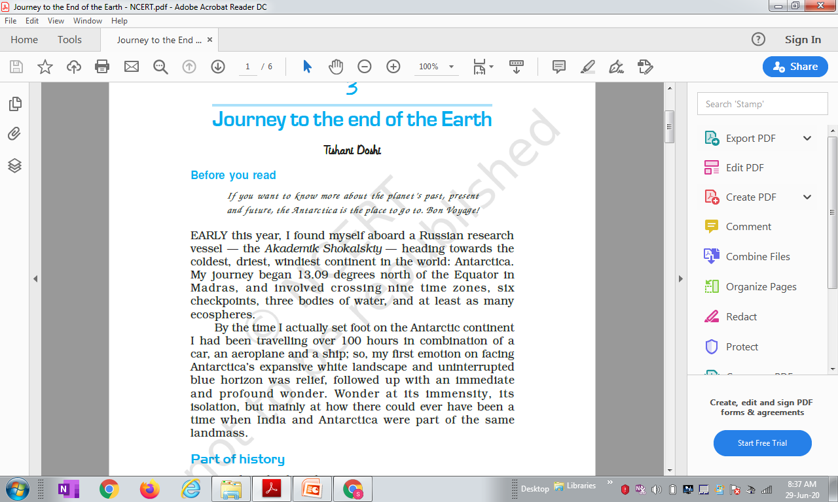
Task 3 Para 1 = “If you want to know………..same landmass”
Read the paragraphs on the left and select a SINGLE WORD each for the meanings given below
a) …..(A phrase in French) = Happy journey
b) … = Widespread
c) … = Very deep
d) … = Largeness
e) … = State of being separated
k) Name the ship Tishani Doshi travelled in to Antarctica.
l) How many days did it take for Tishani Doshi to reach Antarctica ?
m) Which are the 3 modes of travel used by Doshi to travel ?
n) What thought surprised Doshi the most on landing on the shores of Antarctica ?

Slide 6
Task 3 Para 1 = “If you want to know………..same landmass”
Read the paragraphs on the left and select a SINGLE WORD each for the meanings given below
a) …..(A phrase in French) = Happy journey
b) … = Widespread
c) … = Very deep
d) … = Largeness
e) … = State of being separated
f) Name the ship Tishani Doshi travelled to Antarctica.
g) How many days did it take for Tishani Doshi to reach Antarctica ?
h) Which are the 3 modes of travel used by Doshi to travel ?
i) What thought surprised Doshi the most on landing on the shores of Antarctica ?

Slide 7
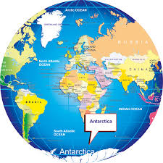
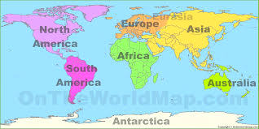
ANTARCTICA
Antarctica, the southernmost continent and site of the South Pole, is a virtually uninhabited, ice-covered landmass. Most cruises to the continent visit the Antarctic Peninsula, which stretches toward South America.
It’s known for the Lemaire Channel and Paradise Harbor, striking, iceberg-flanked passageways, and Port Lockroy, a former British research station turned museum. The peninsula’s isolated terrain also shelters rich wildlife, including many penguins.

Slide 8
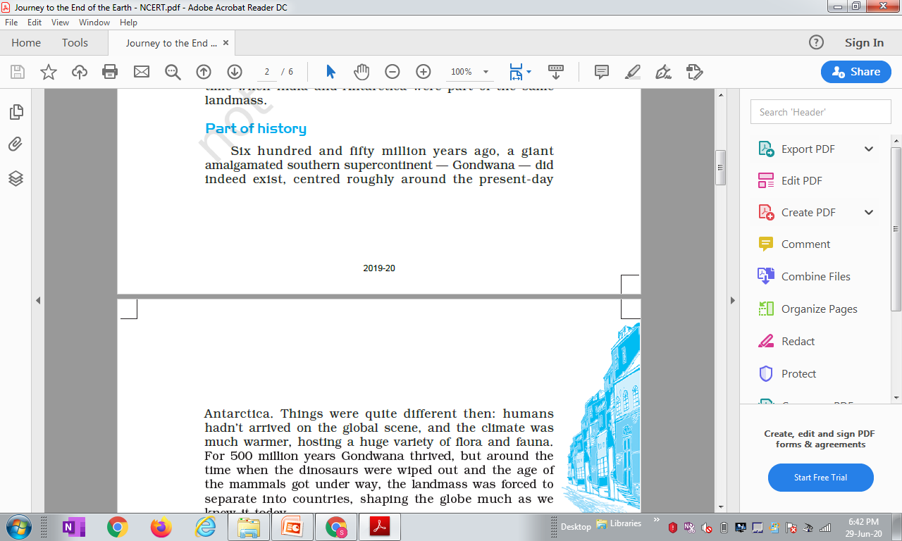
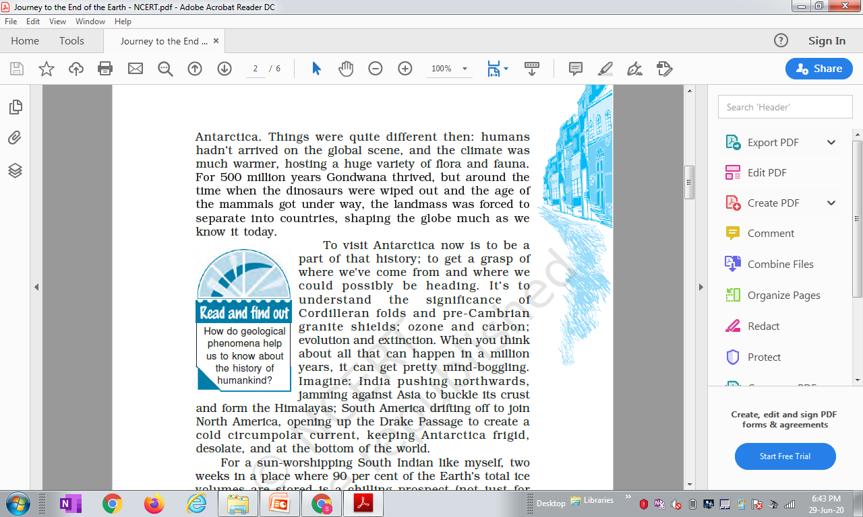
Task 4 Para 2 = “Six hundred and fifty………..bottom of the world”
Read the paragraphs on the left and select a SINGLE WORD each for the meanings given below
a) ….. = 10 lakhs
b) … = United
c) … (phrase) = Plant and animal life
d) … = Animals whose females breastfeed their young ones
e) … = Understanding / Insight
f) … = Importance
g) … = Very surprising
h) … = bend as a result of force
i)… = Extremely cold
j) … = Empty of people
k) Name the southern supercontinent that existed 6500 lakh years ago ?
l) Which were the countries formed when Gondwana split 1500 lakh years ago ? (Find from Google)

Slide 9
Task 4 Para 2 = “Six hundred and fifty………..bottom of the world”
Read the paragraphs on the left and select a SINGLE WORD each for the meanings given below
a) ….. = 10 lakhs
b) … = United
c) … (phrase) = Plant and animal life
d) … = Animals whose females breastfeed their young ones
e) … = Understanding / Insight
f) … = Importance
g) … = Very surprising
h) … = bend as a result of force
i)… = Extremely cold
j) … = Empty of people
k) Name the southern supercontinent that existed 6500 lakh years ago ?
l) Which were the countries formed when Gondwana split 1500 lakh years ago ?
(Africa, South America, Australia, Antartica, Indian subcontinent, Arabian peninsula & Madagascar)

Slide 10
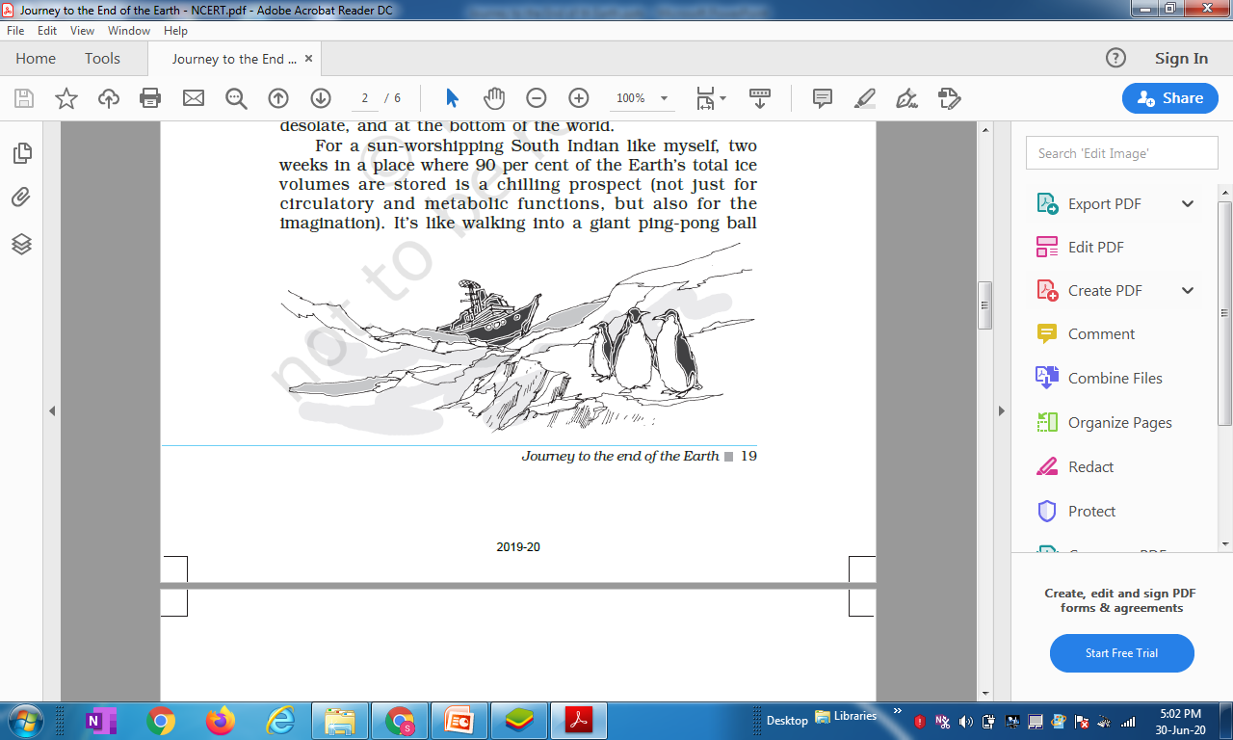
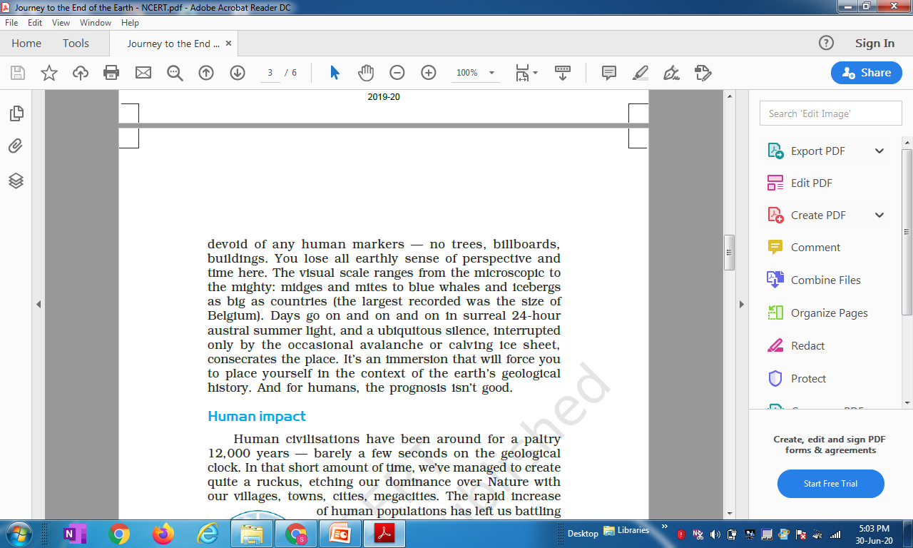
Task 5 Para 3 = “For a sun-worshipping……….prognosis isn’t good.”
Read the paragraphs on the left and select a SINGLE WORD each for the meanings given below
a) … = Causing fear
b) … = Possibility
c) … = life-supporting
d) … = Table tennis
e) … = View / Outlook
f) … = Small flies
g) … = Small insects
h) … = Similar to a dream
i)… = Present everywhere
j) … = Large mass of ice falling from a mountain
k)… = Prediction of future
How many % of the Earth’s total ice volume is found in Australia ?
Why do you think Tishani Doshi says that the future is not good for humanity ?

Slide 11
Task 5 Para 3 = “For a sun-worshipping……….prognosis isn’t good.”
Read the paragraphs on the left and select a SINGLE WORD each for the meanings given below
a) … = Causing fear
b) … = Possibility
c) … = life-supporting
d) … = Table tennis
e) … = View / Outlook
f) … = Small flies
g) … = Small insects
h) … = Similar to a dream
i)… = Present everywhere
j) … = Large mass of ice falling from a mountain
k)… = Prediction of future
How many % of the Earth’s total ice volume is found in Australia ?
Why do you think Tishani Doshi says that the future is not good for humanity ?

Slide 12
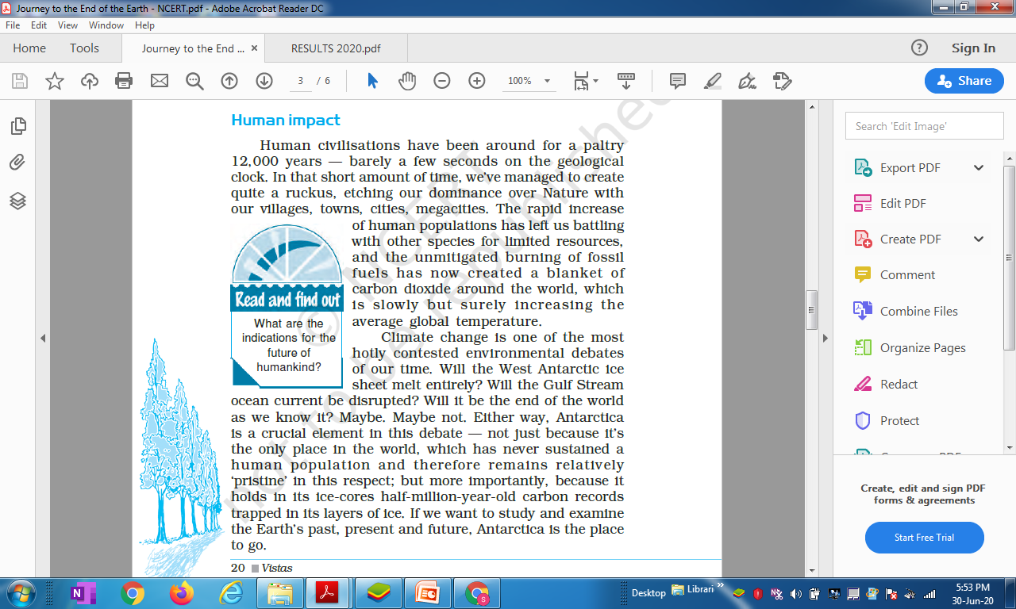
Task 6 Para 4 = “Human Civilisations……….place to go.”
Read the paragraphs on the left and select a SINGLE WORD each for the meanings given below
a) … = Of small value
b) … = A big disturbance
c) … = Leaving a lasting impression
d) … = Supremacy
e) … = Total and complete
f) … = Controversial
g) … = Pure / Unspoiled
h) … = Caught in a trap
i) What is one of the main causes of increase in global temperature ?
j) Why does Tishani Doshi think that the best place to study the past, present and future of the earth is Antarctica ?

Slide 13
Task 6 Para 4 = “Human Civilisations……….place to go.”
Read the paragraphs on the left and select a SINGLE WORD each for the meanings given below
a) … = Of small value
b) … = A big disturbance
c) … = Leaving a lasting impression
d) … = Supremacy
e) … = Total and complete
f) … = Controversial
g) … = Pure / Unspoiled
h) … = Caught in a trap
i) What is one of the main causes of increase in global temperature ?
j) Why does Tishani Doshi think that the best place to study the past, present and future of the earth is Antarctica ?

Slide 14
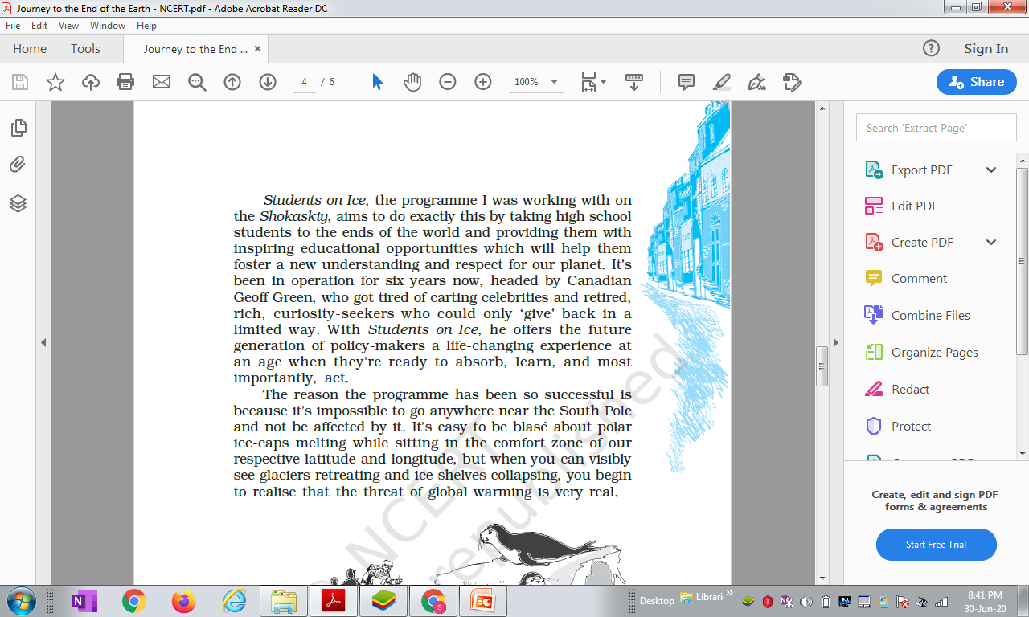
Task 7 Para 5 = “Students on Ice……….is very real.”
Read the paragraphs on the left and select a SINGLE WORD each for the meanings given below
a) … = Chances
b) … = Develop / Grow
c) … = Transporting
d) … = Take in
e) … = Unconcerned
i) What is the name of the programme that took Tishani Doshi to Antarctica? Who heads the programme ? What is its aim?
j) Why is the programme very successful in creating a positve attitude towards global warming ?

Slide 15
Task 7 Para 5 = “Students on Ice……….is very real.”
Read the paragraphs on the left and select a SINGLE WORD each for the meanings given below
a) … = Chances
b) … = Develop / Grow
c) … = Transporting
d) … = Take in
e) … = Unconcerned
i) What is the name of the programme that took Tishani Doshi to Antarctica? Who heads the programme ? What is its aim?
j) Why is the programme very successful in creating a positve attitude towards global warming ?

Slide 16
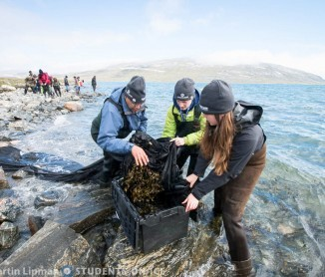
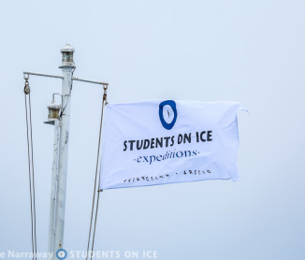
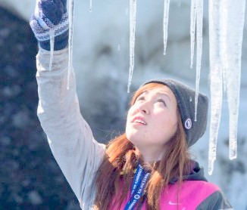
Task 7 continued……
Click on the links below to see video programmes on the international expeditions called “Students on Ice”
https://www.youtube.com/watch?v=o96XWdTZh9I
2. https://www.youtube.com/watch?v=trNvYqAN-SM
In Hindi https://www.youtube.com/watch?v=YS3RXwPjpjA

Slide 17
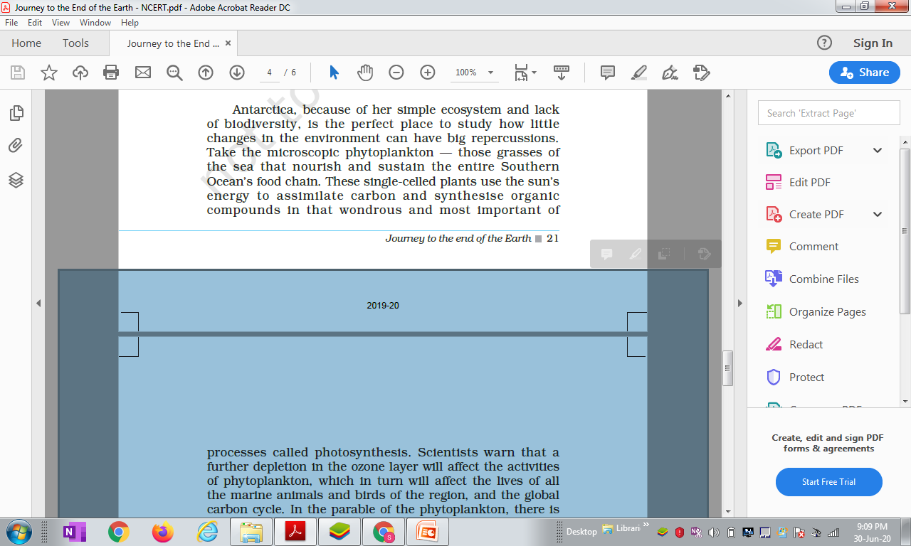
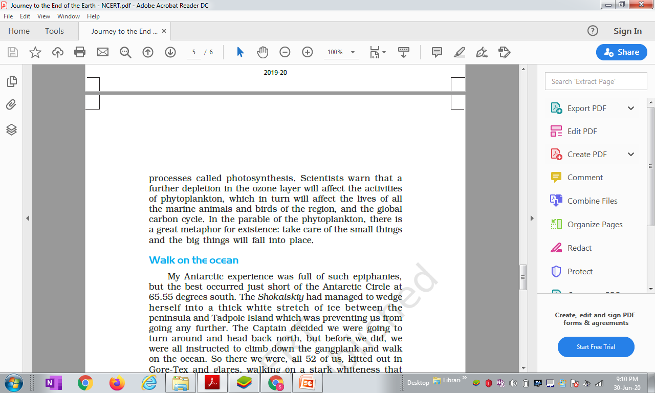
Task 8 Para 6 = “Antarctica, because of ……….fall into place.”
Read the paragraphs on the left and select a SINGLE WORD each for the meanings given below
a) … = Variety of plant and animal life in a region
b) … = Results / Consequences
c) … = Maintain / keep in existence
d) … = absorb / take in
e) … = Combine 2 or more items and make a new product
f)… = Removal / exhaustion
g) … = short narrative
h)…= layer of the atmosphere that absorbs ultraviolet radiation
i) What are phytoplanktons ? How do they contribution to the sustenance of our mother earth ? Get additional information from internet.

Slide 18
Task 8 Para 6 = “Antarctica, because of ……….fall into place.”
Read the paragraphs on the left and select a SINGLE WORD each for the meanings given below
a) … = Variety of plant and animal life in a region
b) … = Results / Consequences
c) … = Maintain / keep in existence
d) … = absorb / take in
e) … = Combine 2 or more items and make a new product
f)… = Removal / exhaustion
g) … = short narrative
h)…= layer of the atmosphere that absorbs ultraviolet radiation
i) What are phytoplanktons ? How do they contribution to the sustenance of our mother earth ? Get additional information from internet.

Slide 19
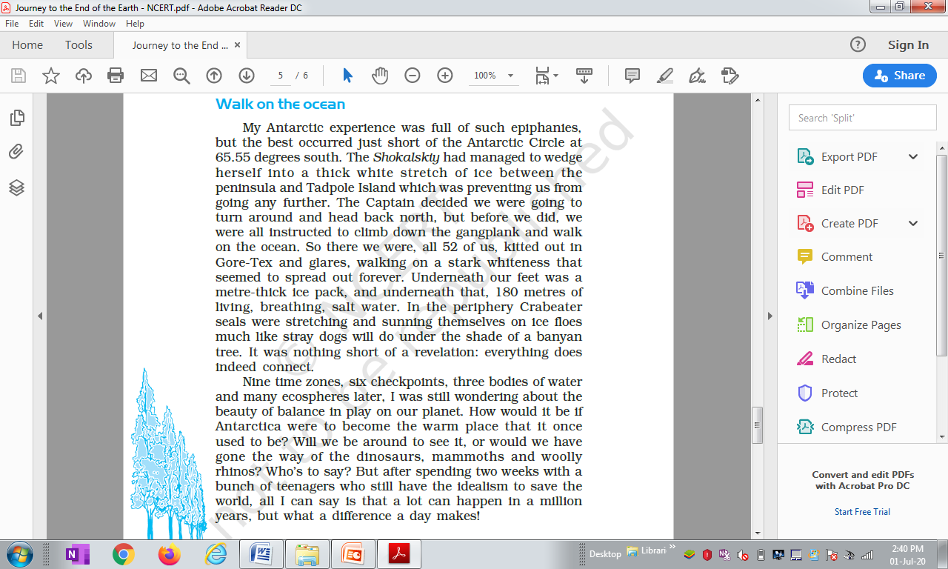
Task 9 Para 7 = “My Antarctic experience ……….a day makes.”
Read the paragraphs on the left and select a SINGLE WORD each for the meanings given below
a) … = Manifestations / discoveries
b) … = Happened
c) … = Force into a narrow gap
d) … = A board used as a temporary footbridge
e) … = Mass of floating ice
f)… = Large elephant-like mammals
g) What does “a stark whiteness that seemed to spread out forever” refer to?
h) Why were Tishani Doshi and other passengers asked by the captain to walk on the ocean ?

Slide 20
Task 9 Para 7 = “My Antarctic experience ……….a day makes.”
Read the paragraphs on the left and select a SINGLE WORD each for the meanings given below
a) … = Manifestations / discoveries
b) … = Happened
c) … = Force into a narrow gap
d) … = A board used as a temporary footbridge
e) … = Mass of floating ice
f)… = Large elephant-like mammals
g) What does “a stark whiteness that seemed to spread out forever” refer to?
h) Why were Tishani Doshi and other passengers asked by the captain to walk on the ocean ?

Slide 21
Task 10 : Post-Reading Activity Test on matching Paragraphs with their themes
Given below are 7 themes found in the 7 paragraphs we have discussed during the course of the lesson, “Journey to the End of the World.” Match the themes with the list of paragraphs mentioned below : Write the theme code a, b, etc against the para nos 1, 2, 3, etc
a) Best place to study the past, present and future of the earth;
b) Small steps Big results;
c) Journey towards Antarctica;
d) A walk on the ice ocean
e) 90% of the Earth’s ice is in Antarctica;
f) Existence of Gondwana;
g) Future generation of policy-makers
Para 1 = “If you want to know………..same landmass” = ………….
Para 2 = “Six hundred and fifty………..bottom of the world” = …………
Para 3 = “For a sun-worshipping……….prognosis isn’t good.” = .………..
Para 4 = “Human Civilisations……….place to go. = …………
Para 5 = “Students on Ice……….is very real.” = ………...
Para 6 = “Antarctica, because of ……….fall into place.” = ………..
Para 7 = “My Antarctic experience ……….a day makes.” = ………..

Slide 22
Task 10 : Post-Reading Activity Test on matching Paragraphs with their themes
Given below are 7 themes found in the 7 paragraphs we have discussed during the course of the lesson, “Journey to the End of the World.” Match the themes with the list of paragraphs mentioned below : Write the theme code a, b, etc against the para nos 1, 2, 3, etc
a) Best place to study the past, present and future of the earth;
b) Small steps Big results;
c) Journey towards Antarctica;
d) A walk on the ice ocean
e) 90% of the Earth’s ice is in Antarctica;
f) Existence of Gondwana;
g) Future generaion of policy-makers
Para 1 = “If you want to know………..same landmass” = ……c…….
Para 2 = “Six hundred and fifty………..bottom of the world” = ……f……
Para 3 = “For a sun-worshipping……….prognosis isn’t good.” = .…...e…..
Para 4 = “Human Civilisations……….place to go. = ……a……
Para 5 = “Students on Ice……….is very real.” = ……g…...
Para 6 = “Antarctica, because of ……….fall into place.” = ……b…..
Para 7 = “My Antarctic experience ……….a day makes.” = ……d…..

Slide 23
Task 11 : Post-Reading Activity Creative / Extended Writing Activity
Imagine you were one of the 52 participants in the Akademik Shokalskiy that went to Antarctica as part of “Students on Ice” programme. Your programme is about to be over and your ship will return within one or two days. Before your return you decide to make a diary entry.
Write a diary entry of your findings, experiences, feelings and apprehensions about the past, present and future of the earth in about 150 words.

Slide 24
Some Quotable Snippets from the lesson
If you want to study and examine the earth’s past, present and future, Antarctica is the place to go.
Take care of the small things and the big things will fall into place– similar to to the ideas of Robert Frost in “Dust of Snow” (Class X poem)

